Slide 1


Slide 2
ABOUT TCGA
The Cancer Genome Atlas(TCGA)癌症基因组图谱是通过大规模基因组测序的分析技术来实现，企图全面加速理解癌症的分子基础。总体目标是提高我们对癌症的诊断、治疗和预防的能力。
美国国立癌症研究所(National Cancer Institute NCI)和美国国立人类基因组研究所(National Human Genome Research Institute NHGRI)分阶段启动TCGA项目。
该项目开发并系统探究了在人类20多种癌症中全基因组图谱的改变中所需的研究框架。

Slide 3
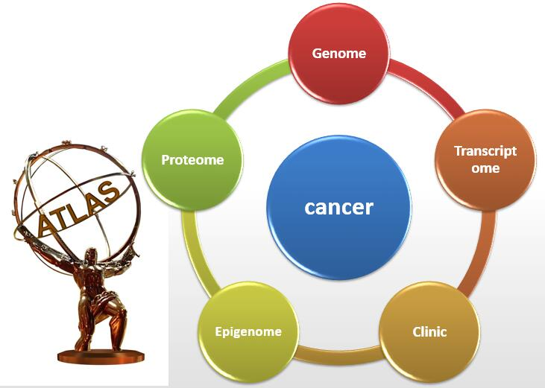
TCGA- the Cancer genome ATLAS

Slide 4
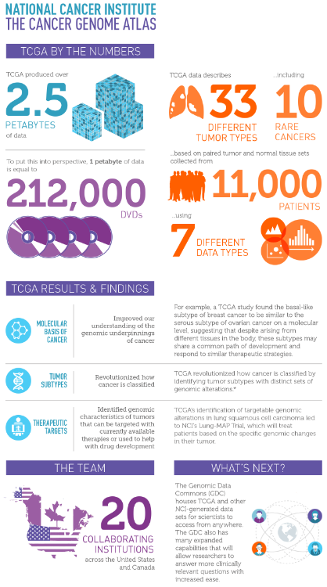
Program overview of the Cancer Genome Atlas (TCGA)
合作机构：Collaboration between the National Cancer Institute (NCI) and National Human Genome Research Institute (NHGRI)
癌症种类：33 types of cancer.
数据库容量集：2.5 petabytes of data describing tumor tissue and matched normal tissues
病人样本量：More than 11,000 patients
数据是否公开：Publically available
PS: The data have contributed to more than a thousand studies of cancer by independent researchers and to the TCGA research network publications.

Slide 5

Why to study cancer genome
In cancer cells, small changes in the genetic letters can change what a genomic word or sentence means. A changed letter can cause the cell to make a protein that doesn’t allow the cell to work as it should. These proteins can make cells grow quickly and cause damage to neighboring cells.
By studying the cancer genome
（1）scientists can discover what DNA changes cause a cell to become a cancer.
（2）the genome of a cancer cell can be used to classify cancer type.
（3）understanding the cancer genome may also help a doctor select the best treatment for each patient.

Slide 6
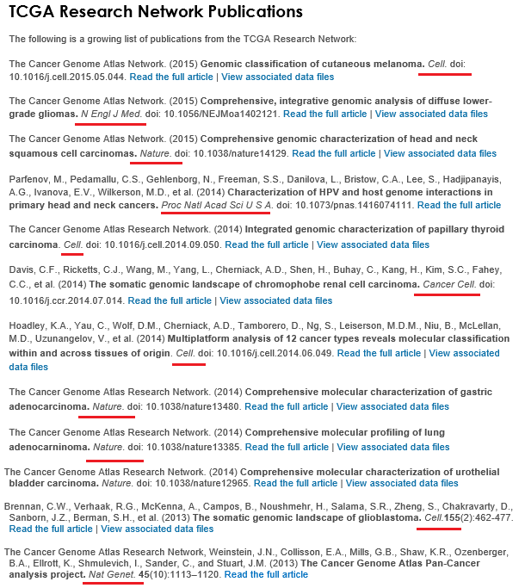
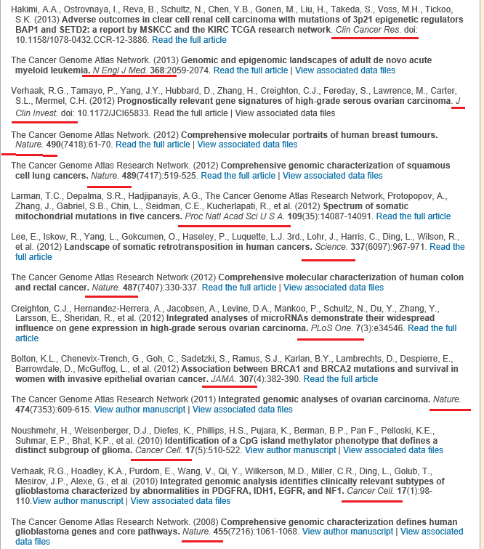
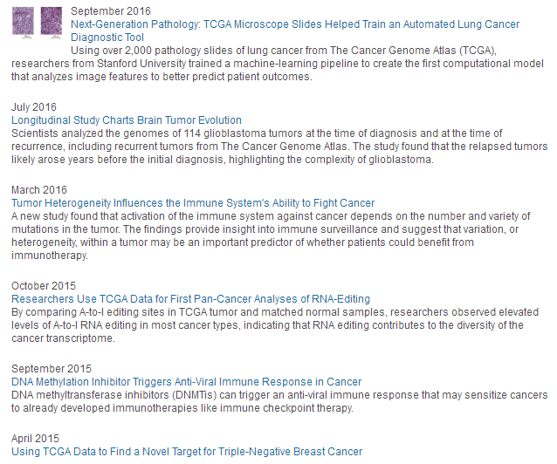

TCGA数据库广泛应用于科研

Slide 7
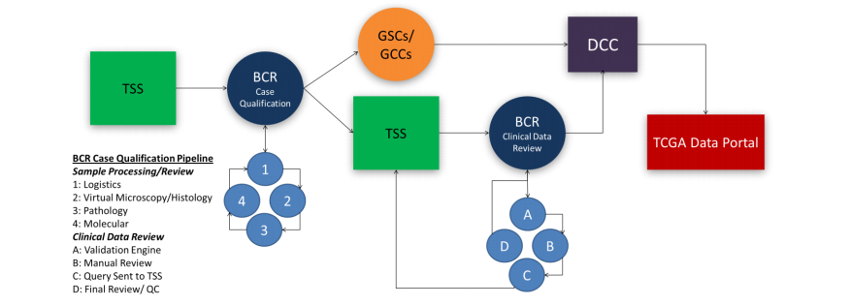
TCGA项目团队
包括4个部门：TSS，BCR，DCC，GCCs/GSCs，各部门互相配合完成数据库的建设。
TSS: 负责临床数据的收集以及组织。
BCR: 负责所有技术类型数据的组织。
DCC：负责各种数据各个水平的整理分类。
GCCs /GSCs 分别为鉴定中心和测序中心。
所以有的样本虽然有BCR archive，但未必有实际存在的data archive，尤其是作为对照的正常样本。

Slide 8
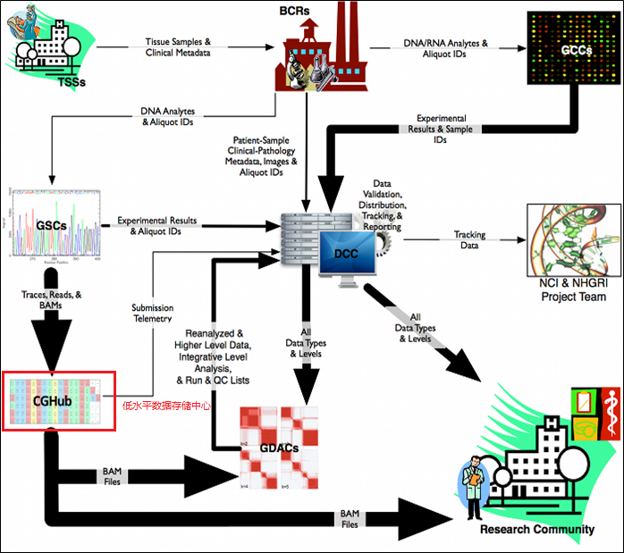
数据产生历程
TCGA数据的产生历程：
1. 组织样本和临床数据来源网站(TSS)收集的数据发送到Biospecimen核心资源(BCRs)。
2. BCRs提交临床数据和元数据到数据协调中心(DCC)和测序中心(GSCs),获取组织变异数据,然后提交给DCC。
3. GSCs提交跟踪文件,序列比对后文件到癌症基因组学中心(CGHub)。
4. 提交给DCC和CGHub的数据可供研究团队和基因组数据分析中心(GDACs)使用。
5. 分析pipeline以及由GDACs产生的数据结果通过DCC保存到研究社区（community）中。

Slide 9
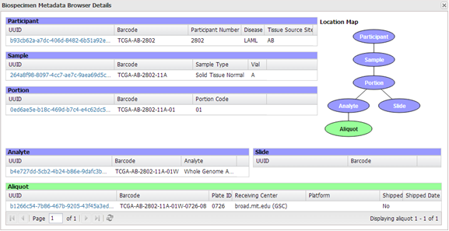
数据组织形式
数据的组织形式主要以barcode方式组织，每一个barcode对应为一个病人样本，barcode的数据格式如下。目前TCGA正转向以uuid的形式组织数据。
数据示例如下：TCGA-AB(tissue id , Bone-marrow-aspirate) -2999(patient id) -03(sample-type,11-nomal)A(vial-abcd)-01(portion id)T(测序数据analyte type)-0735(测序平台plate id)-13(测序团队center id)。

Slide 10
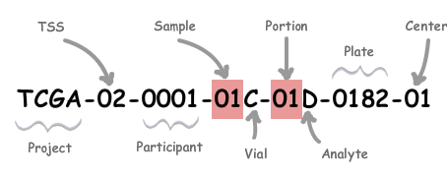
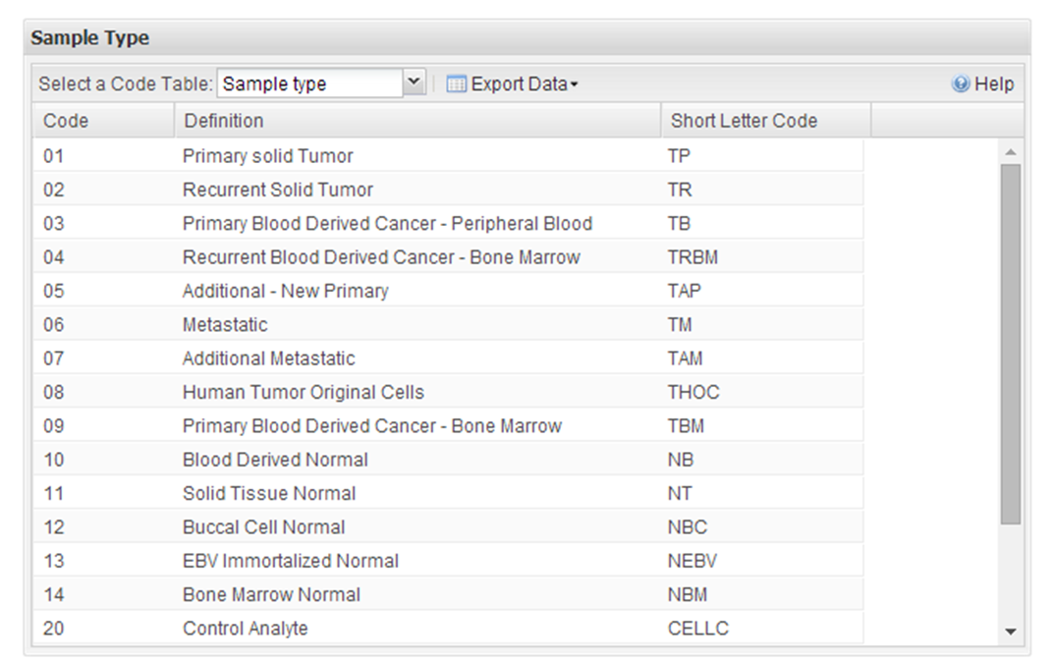
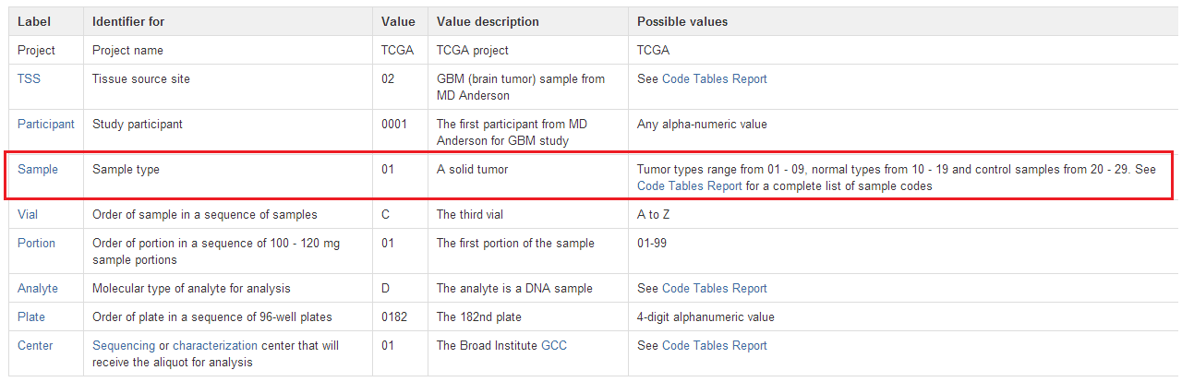
barcode解读
数据的组织形式主要以barcode方式组织，每一个barcode对应为一个病人样本
详细请见：https://wiki.nci.nih.gov/display/TCGA/TCGA+barcode

Slide 11
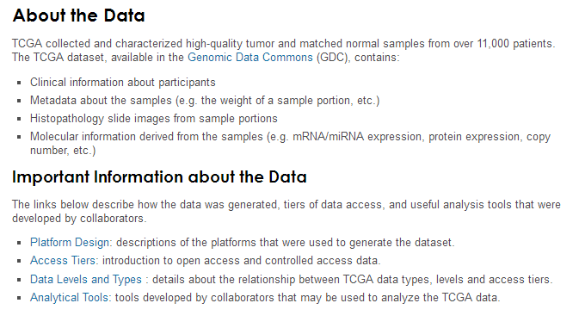
ABOUT cancer DATA
数据发布于GDC平台

Slide 12
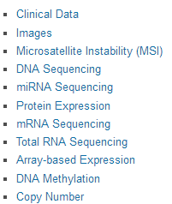
DATA TYPES AND LEVELS
DATA TYPES

Slide 13
DATA LEVELS
Data Level | Level Type |  | Description
1 | Raw | Low-level data for single sample | 单个样本的低级数据
 |  | Not normalized | 未标准化
2 | Processed | Normalized single sample data | 标准化的单个样本
 |  | Interpreted for presence or absence of specific molecular abnormalities | 解释异常的个体
3 | Segmented/ Interpreted | Aggregate of processed data from single sample | 单个样本整合在了一起
 |  | Grouped by probed loci to form larger contiguous regions (in some cases) | 根据probe位置分组
4 | Summary/Regions of Interest (ROI) | Quantified association across classes of samples | 量化关联类的样本
 |  | Associations based on two or more | 两个或多个的关联
 |  | Molecular abnormalities | 分子水平的异常
 |  | Sample characteristics | 样本特性
 |  | Clinical variables | 临床变异

Slide 14
注意：
低水平测序数据存储在cghub https://cghub.Ucsc.Edu/，申请下载时需要DUNS number.
The cancer genomics hub (cghub) is a secure repository for storing, cataloging, and accessing cancer genome sequences, alignments, and mutation information from the cancer genome atlas (tcga) consortium and related projects.

Slide 15
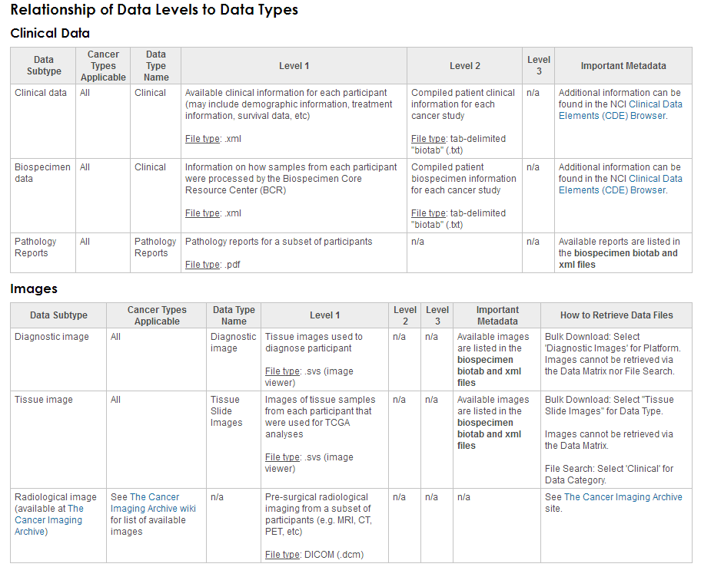
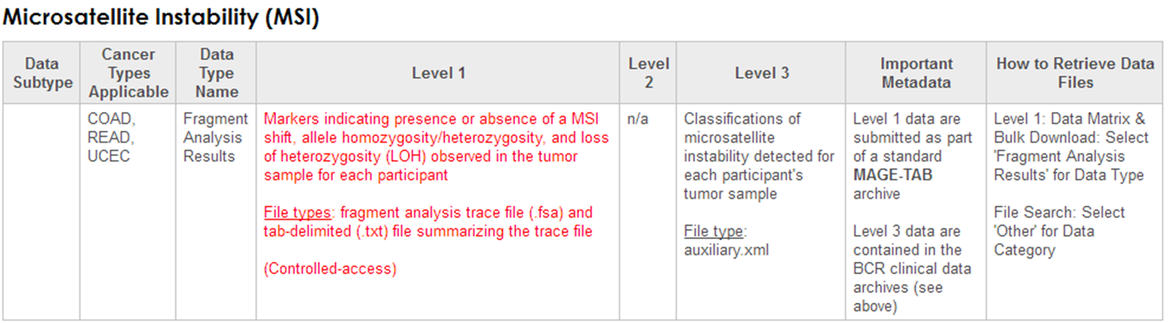

Slide 16
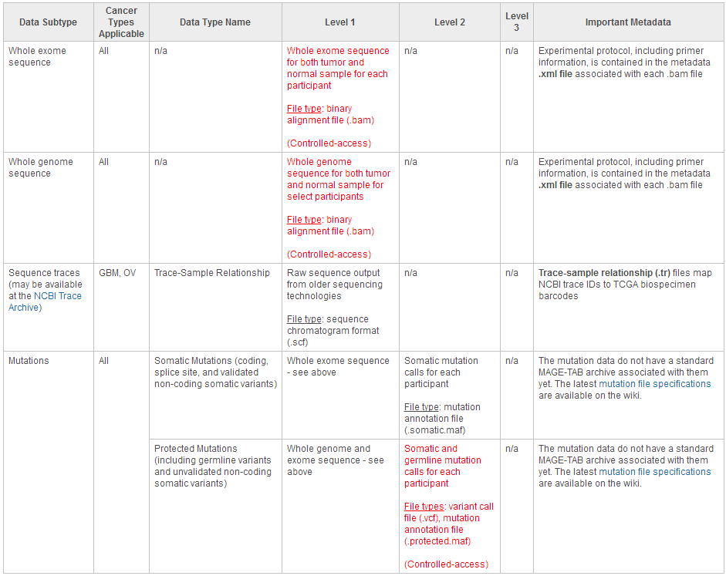
Dna sequencing

Slide 17
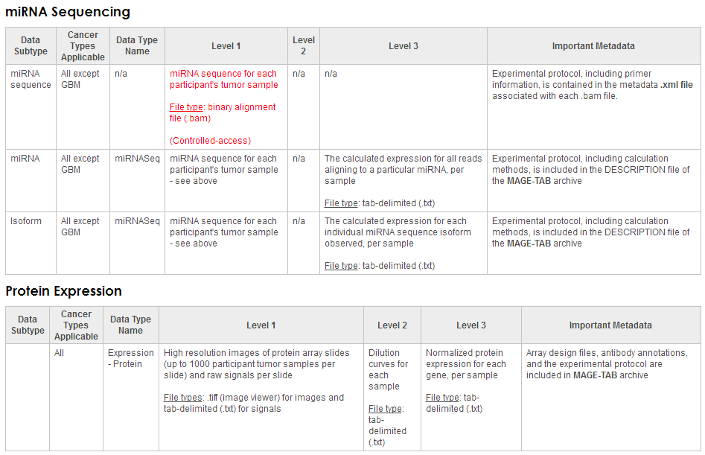

Slide 18
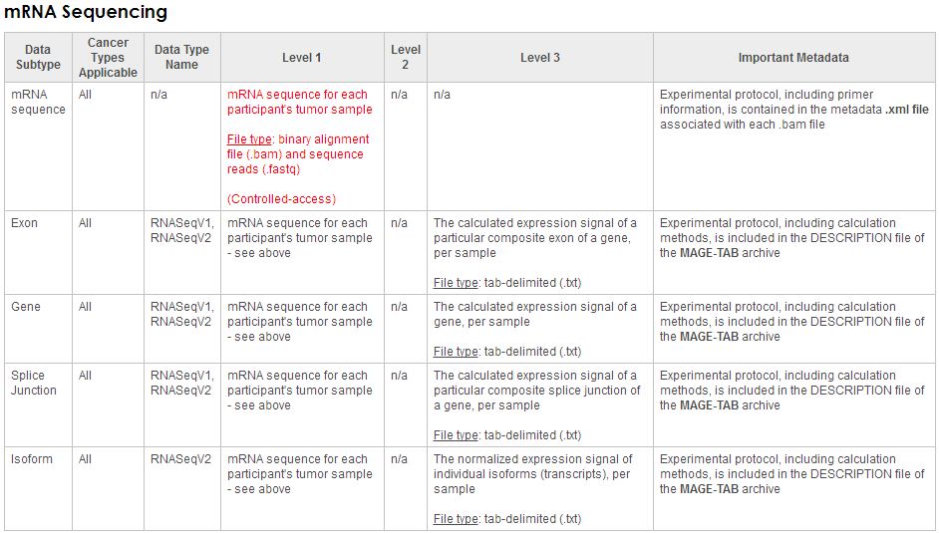

Slide 19
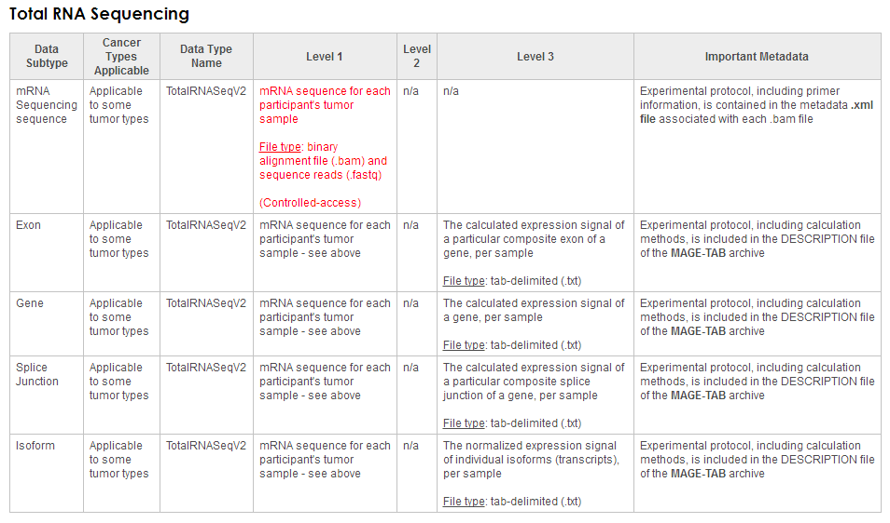
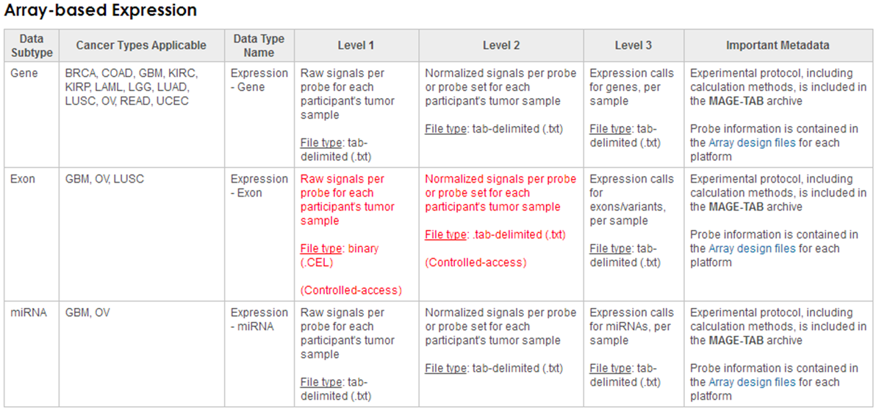
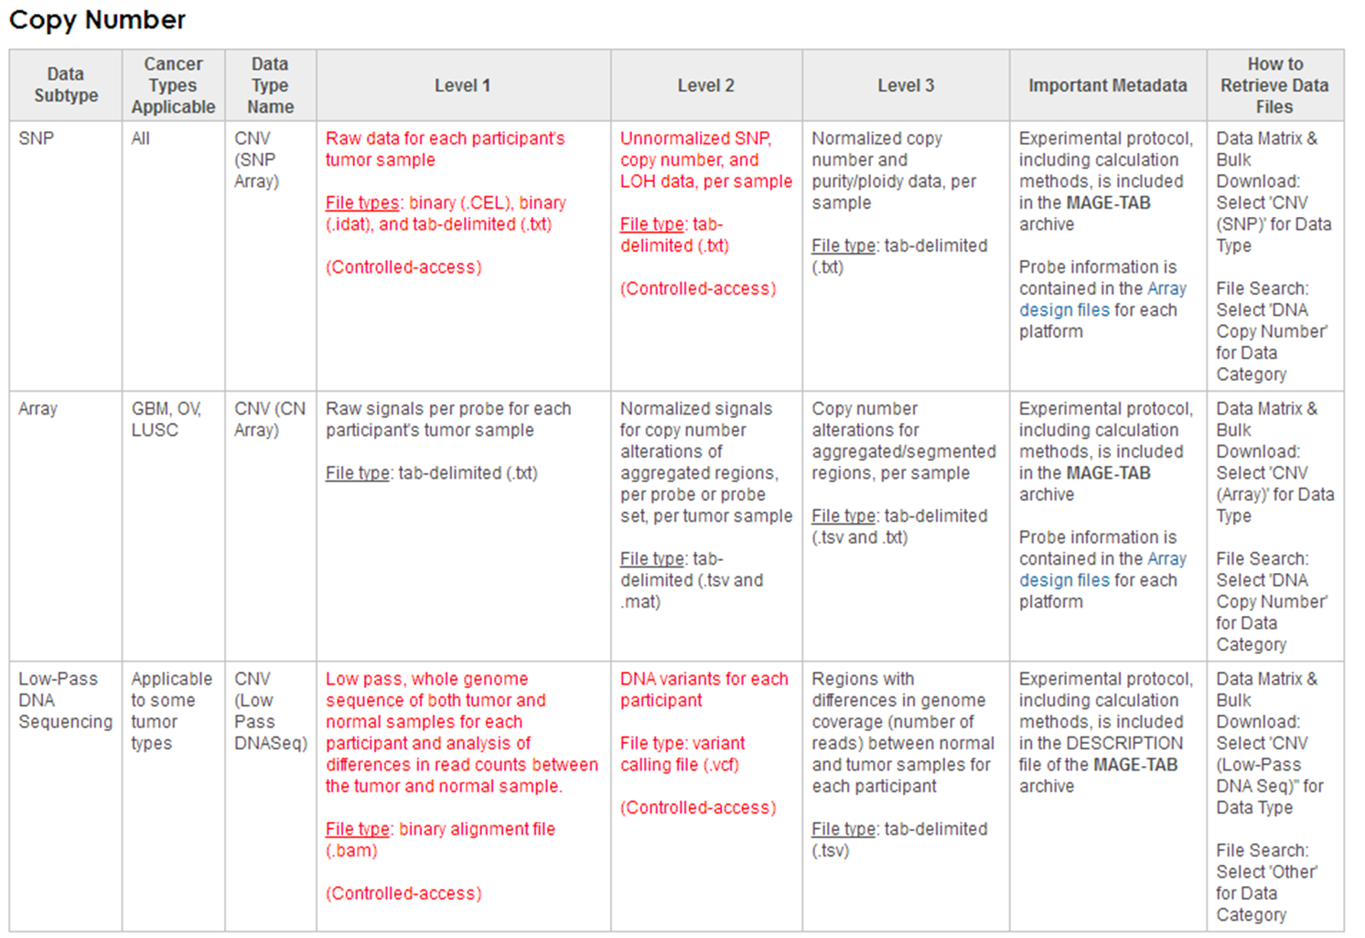
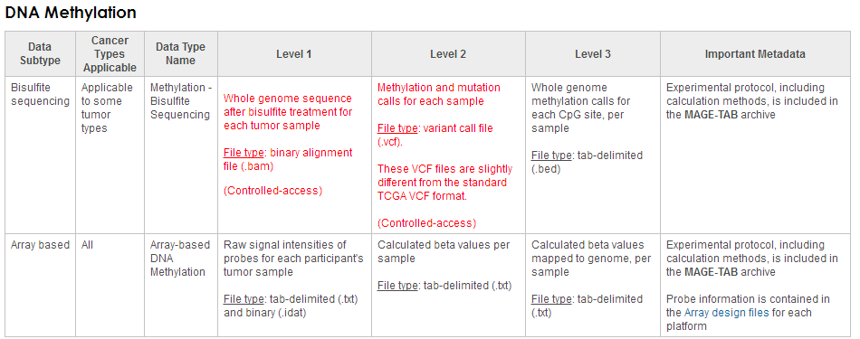

Slide 20

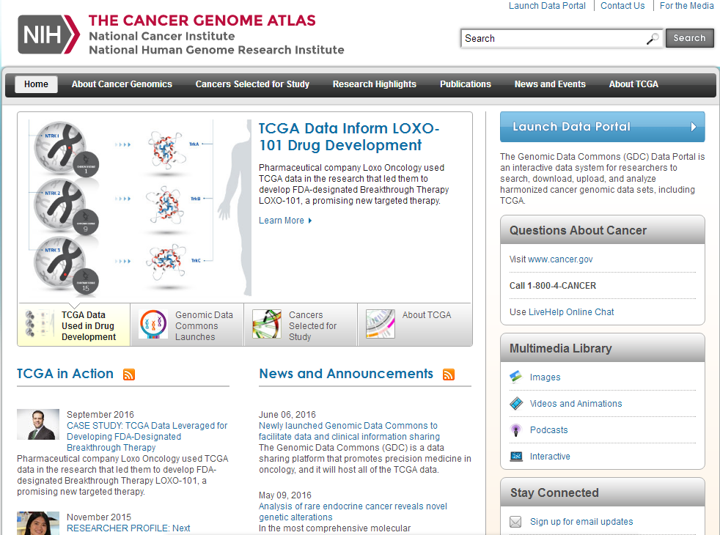
TCGA网站首页
点击进入

Slide 21
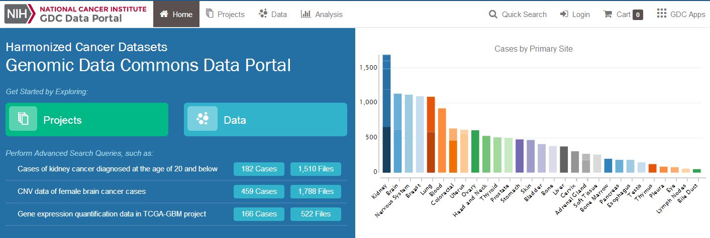
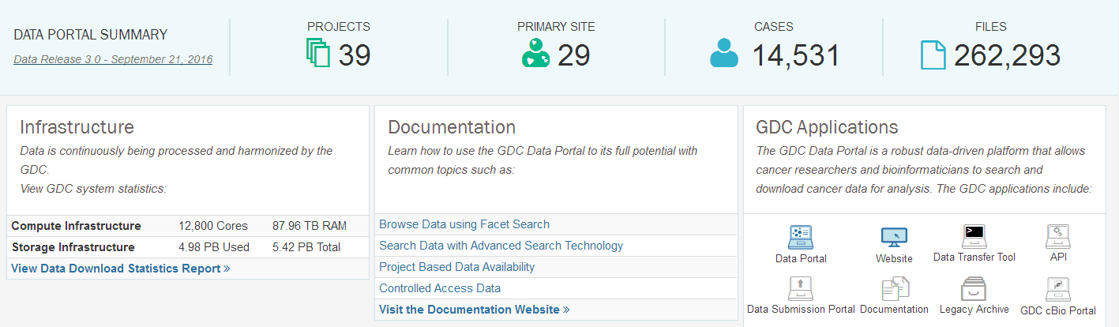
癌症类别
数据类别
2016.9.21发布3.0数据库版本，数据形式说明详见：
https://gdc-docs.nci.nih.gov/Data/Release_Notes/Data_Release_Notes/#new-updates

Slide 22
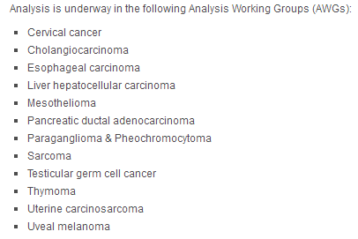
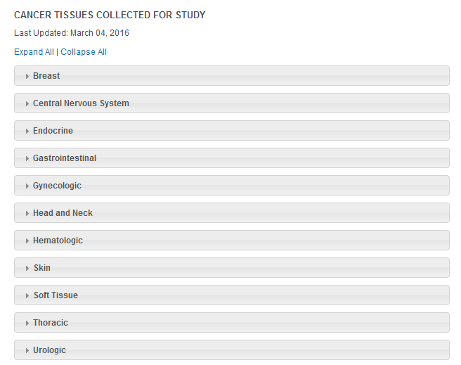
Cancers Selected for Study
The cancer genome atlas (TCGA) has chosen cancers for study based on specific criteria that include：
（1）poor prognosis and overall public health impact
（2）availability of human tumor and matched-normal tissue samples that meet TCGA standards for patient consent, quality and quantity

Slide 23
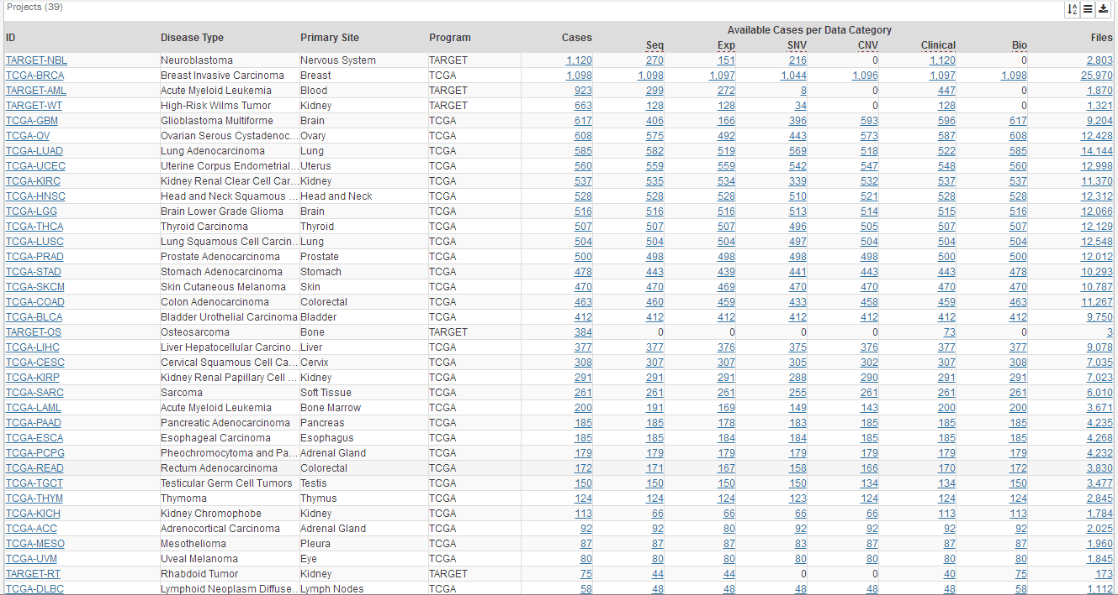
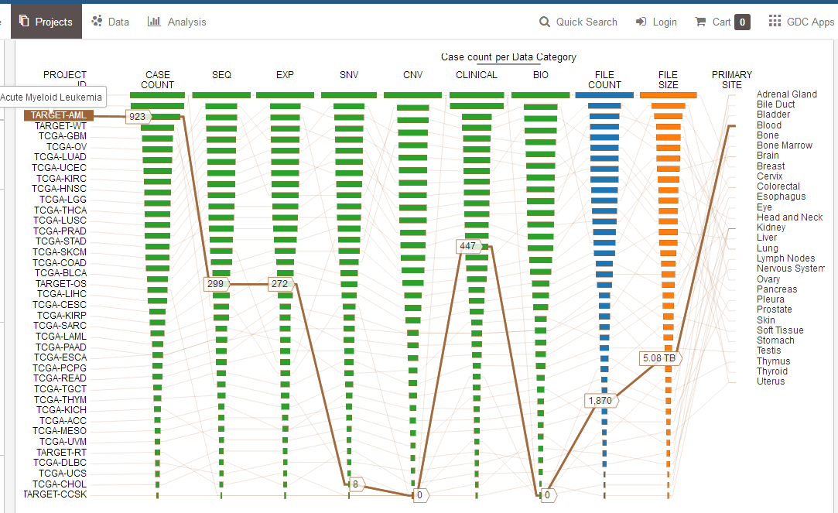
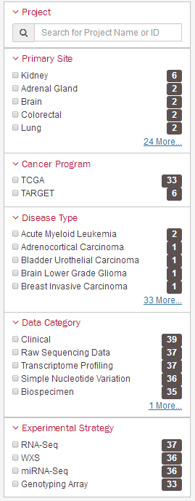
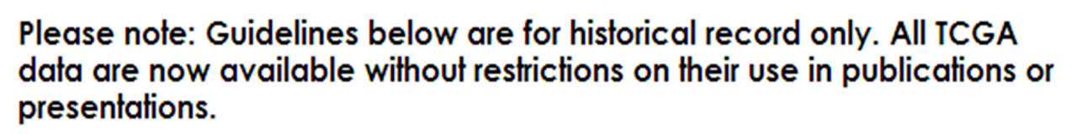
癌症种类丰富 样本量大
33 种cancer
数据展现形式：Table / Graph

Slide 24
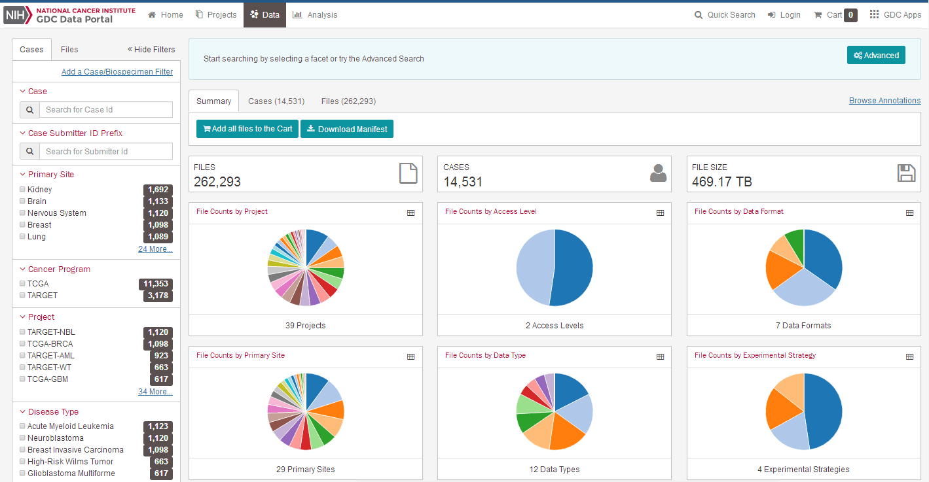

Slide 25
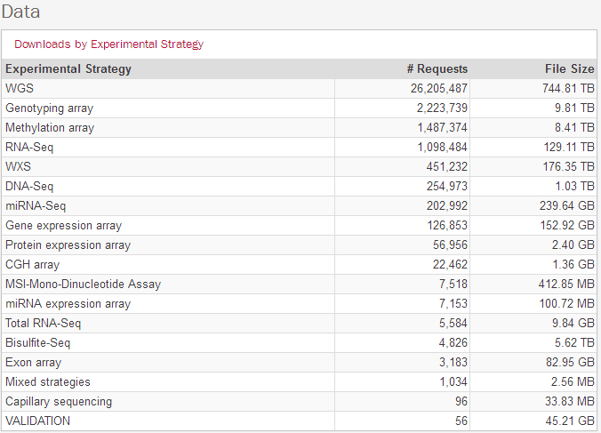
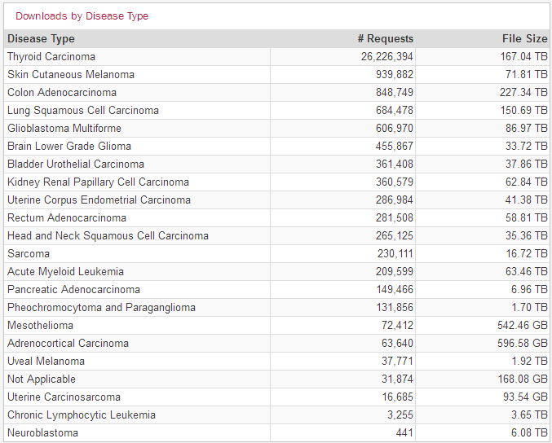
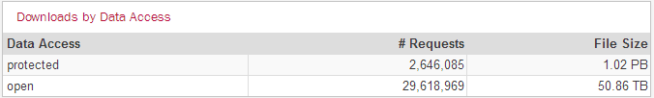
Data Download Statistics（数据大部分是公开的）

Slide 26
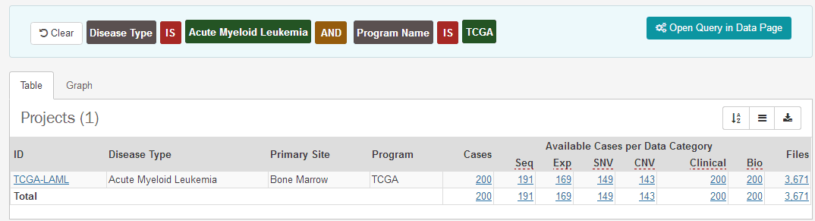
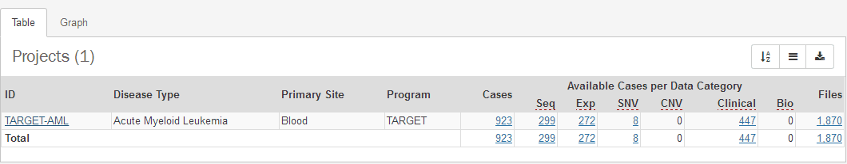
以AML为例：在新版TCGA数据库中，AML具有两种不同的数据形式（projects）：TCGA和TARGET
1. TCGA形式
2. TARGET形式

Slide 27
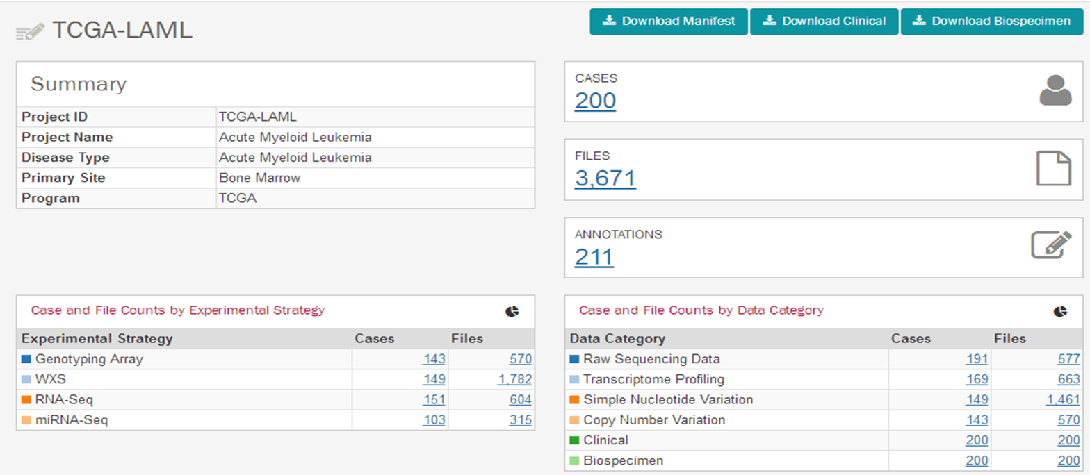
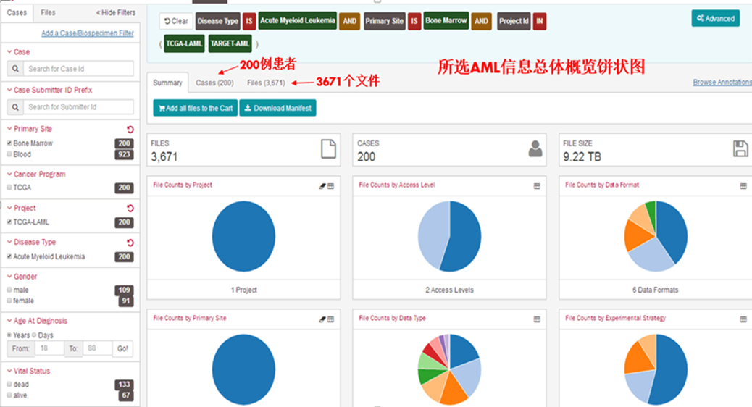
1. TCGA形式的AML数据概览

Slide 28
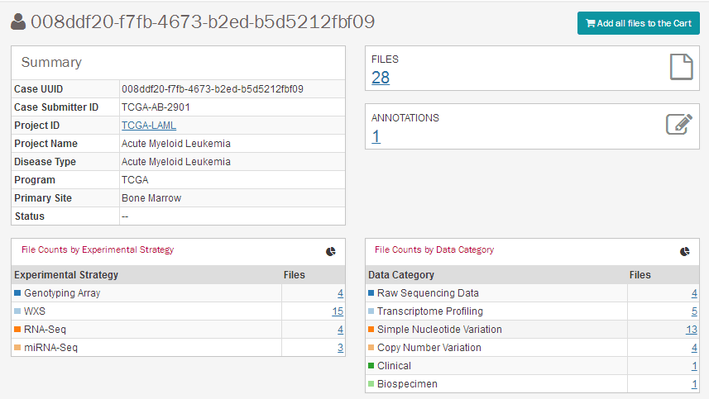
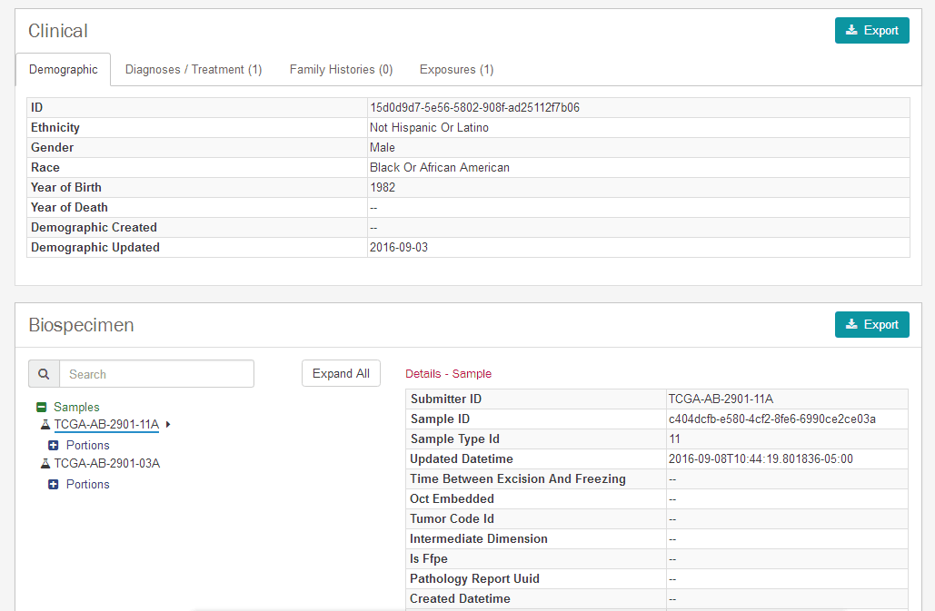
点击case进入，选中第一行 CASE UUID购物车里的28个文件，可查询临床样本具体数据信息，并以jason格式输出

Slide 29
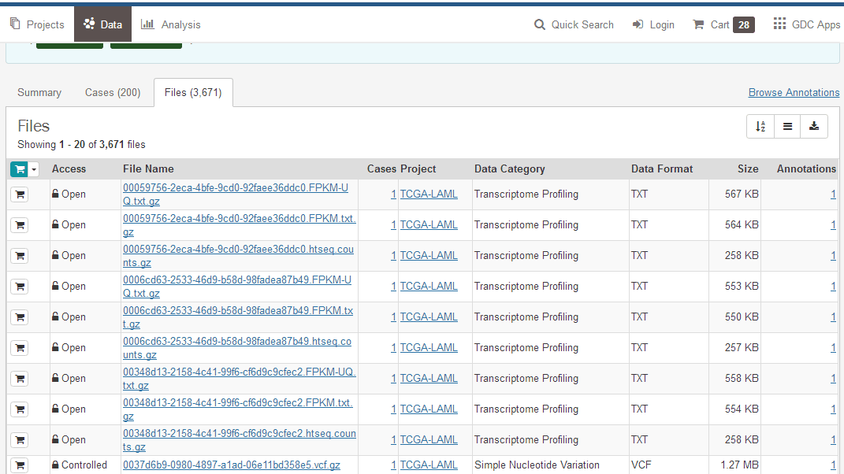
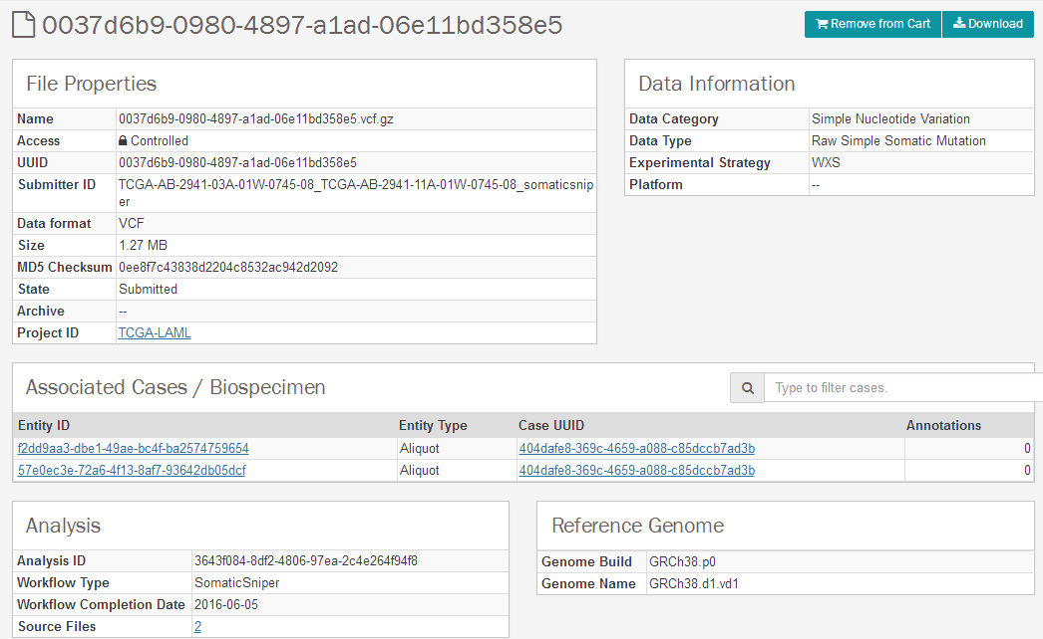
点击Files进入，可见文件类型有Open和Controlled两种类型，标明Open的文件可直接下载
Controlled表示需要获得下载权限才可下载数据，但仍可查询是受保护的是哪一类数据及其信息

Slide 30
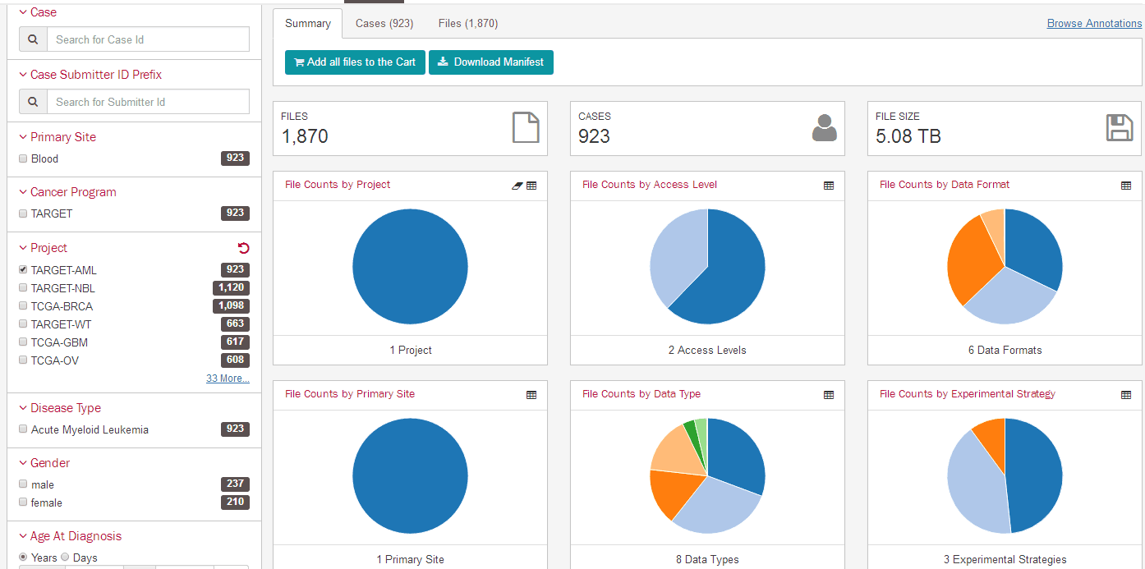
2. TARGET形式的AML数据概览
注：TARGET数据是Therapeutically Applicable Research To Generate Effective Treatments
其他查询具体样本信息的方式如前TCGA形式的AML所述，样本信息中同样存在Controlled的部分，因此不再赘述

Slide 31
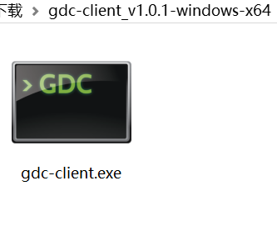
The GDC Data Transfer Tool: An Overview
GDC数据下载工具说明
Raw sequence data, stored as BAM files, makes up the bulk of data stored at the NCI genomic data commons (GDC). The size of a single file can vary greatly. Most BAM files stored in the GDC are in the 50 MB - 40 GB size range, with some of the whole genome BAM files reaching sizes of 200-300 GB.
The gdc data transfer tool provides an optimized method of transferring data to and from the gdc, and enables resumption of interrupted transfers.
GDC Data Transfer Tool
The system recommendations for using the GDC Data Transfer Tool are as follows:
•OS: Linux (Ubuntu 14.x or later), OS X (10.9 Mavericks or later), or Windows (7 or later)
•CPU: At least eight 64-bit cores, Intel or AMD
•RAM: At least 8 GiB
•Storage: Enterprise-class storage system capable of at least 1 Gb/s (gigabit per second) write throughput and sufficient free space for BAM files.

Slide 32
Accessing Built-in Help:
./gdc-client
usage: gdc-client [-h] [--version] {download, upload, interactive} ...
gdc-client: error: too few arguments
./gdc-client download –help
./gdc-client upload –help
Preparing for Data Download and Upload
The GDC Data Transfer Tool is intended to be used in conjunction with the GDC Data Portal to transfer data to or from GDC. First, the GDC Data Portal’s interface is used to generate a manifest file or obtain UUID(s) and (for controlled data) an authentication token. The GDC Data Transfer Tool is then used to transfer the data files listed in the manifest file or identified by UUID(s).

Slide 33
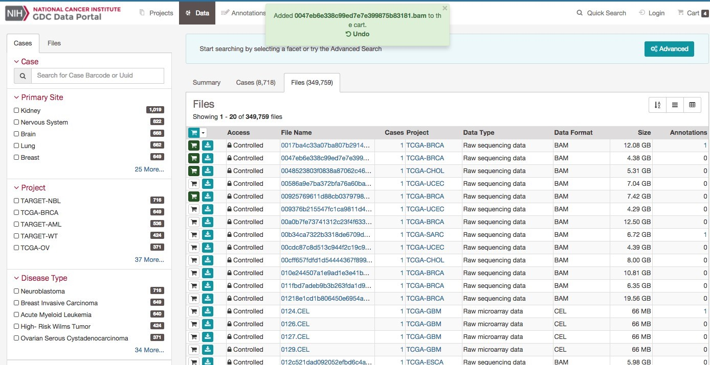
Obtaining a manifest file for data download
GDC 数据传输工具支持下载的 GDC 清单文件中列出的多个文件。清单文件，可以生成和直接从 GDC 数据门户网站下载。
选择感兴趣的数据文件。单击购物车按钮与感兴趣的文件对应的行中。按钮将变为绿色，表明该文件已被选定。

Slide 34
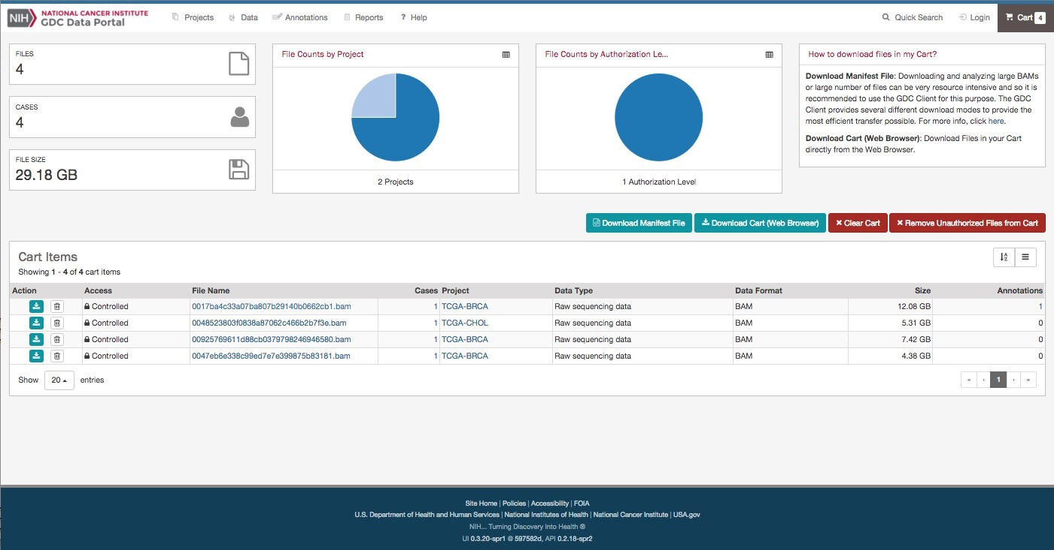
GDC Data Portal: Selecting Files of Interest
说明：（1）一旦选择了感兴趣的所有文件，可单击购物车按钮在右上角。
（2）遂弹出购物车页，条目已概述当前选定的所有文件。
（3）即可作为一个清单文件下载此文件列表，通过点击蓝色下载清单按钮

Slide 35
Downloads: （下载数据）
Downloading data using a manifest file
Gdc-client download -m gdc_manifest_6746fe840d924cf623b4634b5ec6c630bd4c06b5.Txt
Downloading data using gdc file uuids
Gdc-client download 22a29915-6712-4f7a-8dba-985ae9a1f005
Gdc-client download e5976406-473a-4fbd-8c97-e95187cdc1bd fb3e261b-92ac-4027-b4d9-eb971a92a4c3
Resuming a failed download
Gdc-client download f80ec672-d00f-42d5-b5ae-c7e06bc39da1
Downloading controlled data
Gdc-client download -m gdc_manifest_e24fac38d3b19f67facb74d3efa746e08b0c82c2.Txt -t gdc-user-token.2015-06-17t09-10-02-04-00.Txt
1. 使用由 GDC 数据门户生成清单文件。生成后的清单文件 ，使用 GDC 数据传输工具通过提供清单选项启动下载，后面跟着存储位置和清单文件名称。
2. GDC 数据传输工具还支持使用 UUID(s) 文件的一个或多个单个文件的下载。要做到这一点，请在下载命令后输入 UUID(s)。
3. GDC 数据传输工具支持恢复中断的下载。若要恢复不完整的下载，请重复下载清单或 UUID(s) 在初始下载相同的文件夹中。
4. 用户身份验证令牌所需的 GDC 下载控制（未开放）数据。
。

Slide 36
Uploads:
Uploading data using a manifest file
Gdc-client upload --manifest manifest.Yml --token-file token.Txt
Uploading data using a gdc file uuid
Gdc-client upload -i cd939bdd-b607-4dd4-87a6-fad12893932d -t token.Txt
Resuming a failed upload
Gdc-client upload -m manifest.Yml -t token
Replacing previously uploaded data
Gdc-client upload -m manifest.Yml -t token --delete
GDC 数据传输工具支持使用清单文件上传数据。数据捆绑的清单文件，可从 GDC 数据提交，检索或直接从 GDC 提交 。
2. GDC 数据传输工具还支持上传使用 UUID 文件的数据。
3. 以前上传的数据可以用新数据代替。

Slide 37
TCGA database related Analytical Tools
Analysis tools allow users to interact intuitively with the GDC data, and can also be accessed with programmatic interfaces.
（1）cbioportal for cancer genomics （http://www.Cbioportal.Org/）
（2）broad firehose ：http://firebrowse.Org/（这个网站需要翻墙才能打开！！）
The cBioPortal for Cancer Genomics provides visualization, analysis, and download of large-scale cancer genomics data sets.
The Broad Firehose provides analyses of interpreted and summarized data packaged in a form amenable to immediate algorithmic analysis. This enables a wide range of cancer biologists, clinical investigators.
The Broad Firehose is being extended to support the analysis of GDC data.

Slide 38


Slide 39
cBio Cancer Genomics Portal简介
提供研究分析癌症基因数据的可视化工具，使复杂的癌症基因组学资料更易理解和接受，不需要特殊的生物信息学背景。cBio Portal可以帮助癌症组织和细胞学研究获得的分子生物学数据认识及理解遗传、表观遗传、基因表达和蛋白质组学。
2. 数据来源
主要来自大样本癌症基因组计划
如：癌症基因图谱(Cancer Genome Atlas, TCGA)
国际癌症基因组联盟(The International Cancer Genome Consortium, ICGC)
The Broad Institute's Genome Data Analysis Center (GDAC)
…….
迄今为止，cBioPortal包含了10已发表的肿瘤研究结果和20多个TCGA的结果，每个肿瘤样本和数据均可从上述网站下载。
cBio Cancer Genomics Portal将收集得到的数据进行整合、分析，为不熟悉计算机操作、无生物信息学背景的研究人员提供便利。

Slide 40
主要功能
（1）cBioPortal以可视化的角度分析基因、样本和数据类型，方便了研究人员探求多维癌症基因组数据，可通过查询，验证一些假设。
（2）cBioPortal将收集的临床样本从基因水平上进行整合和简化，数据类型包括：体细胞突变，DNA拷贝数改变，mRNA和microRNA表达，DNA甲基化，蛋白丰度以及磷酸化蛋白丰度。感兴趣的基因均可查询其特定的生物学特性，如基因突变率，纯合子缺失率，基因扩增率，mRNA和miRNA的增加或减少，蛋白质的增加或减少等。
（3）cBioPortal提供的分析选项有癌症基因组数据，基因水平改变的引起的相关生物功能变化，综合分析基因组数据和临床资料，患者数据等。

Slide 41
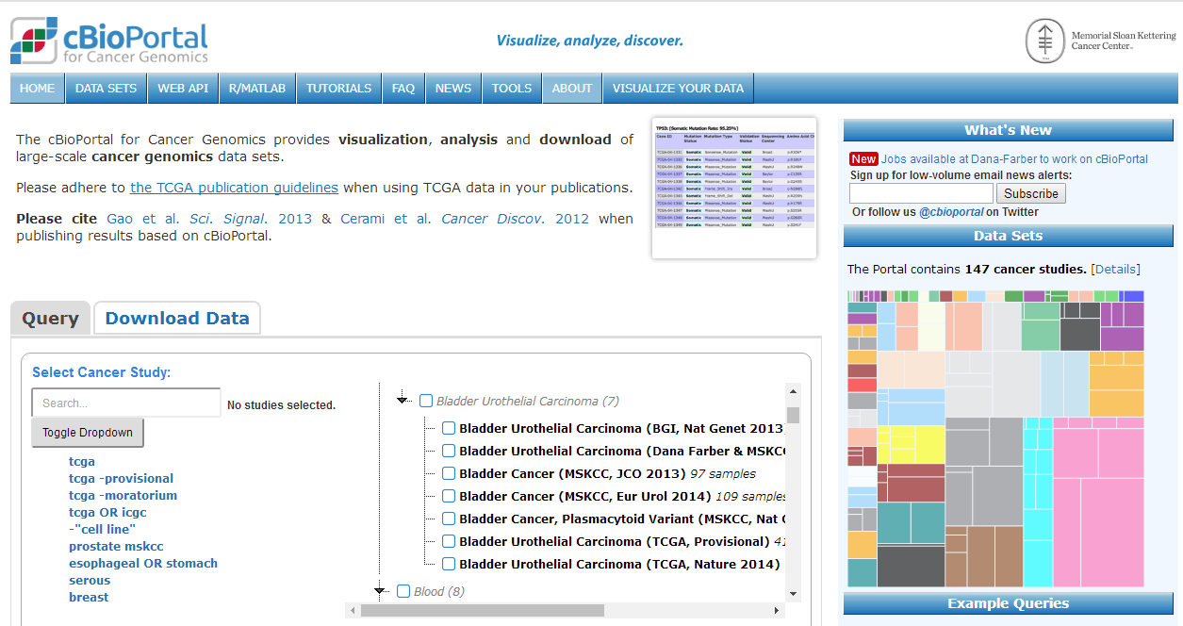
http://www.cbioportal.org/

Slide 42

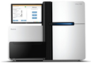
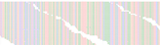







The cbioportal for cancer genomics: data to knowledge
Tumor DNA / RNA
DNA sequencer, microarrays …
Data
Tumor and normal sequences
biologists
clinicians
bioinformaticians
Knowledge
Intuitive interface, quick response times, reduction of data complexity

Slide 43

Key abstraction: gene alteration events per sample
Which genes are altered in each individual tumor sample?
Data type | Alteration event calls
Mutations | Non-synonymous somatic mutations
Copy number changes | Homozygous deletion or amplification
Methylation | Epigenetic silencing
mRNA and/or DNA | Gene fusions
mRNA expression changes | Over- or under-expression
Alteration types and thresholds can be customized for each gene

Slide 44


患者信息
相关的病理切片
关键的突变基因
基因名称 蛋白质变异 注释 突变类型 等位基因频率 表达水平
（无义）
病理切片查看、缩放

Slide 45



患者用药情况
患者基因突变情况
患者临床信息

Slide 46



cBioPortal for Cancer Genomics: Three modes of access
Queries across a cohort: Example Breast Cancer

Slide 47


2. Cross-cancer queries: example ERBB2

Slide 48


3. Visualization / interpretation of individual tumor samples

Slide 49



The cBioPortal for Cancer Genomics: Data
cBioPortal
TCGA
COSMIC
Drugbank, PharmKGB, NCI Cancer Drugs
Pathway Commons
clinicaltrials.gov
Published studies
Private data
Whole exome
TCGA: ~7,500 samples from >20 studies.
Other studies: ~4,000 samples from >40 studies.
Targeted sequencing
~1,000 samples from 10 studies
CCLE: 883 samples

Slide 50

New features: Multiple samples & patient timeline

Slide 51


Slide 52

http://firebrowse.org/（这个网站需要翻墙才能打开！！）

Slide 53


~1500 analyses (reports) per run Find your favorite in 2 clicks
Choose Cohort
Data Type

Slide 54


Many 1000s of datasets per run
Find your favorite in 2 clicks
以AML为例
Choose Cohort
Data type
Click to Download

Slide 55

Or download everything with 1 click

Slide 56

Graphical tools
View Gene: expression level browser

Slide 57



选择其中感兴趣的疾病

Slide 58

iCoMut Beta for FireBrowse

Slide 59

Mutation R ate
Muta tion R a te
15
Astrocytoma
Oligoastrocytoma
OligodendrocytomaOligodendroglioma
iCoMut
s ynonymous
non s ynonymous
10
5
Mutation rate
By making such figures
interactive, allowing
panels to be moved,
sorted and searched,
iCoMut dramatically
enhances that process.
0
C linical Age
age
C linical Vital S tatus
v ita l s ta tus
Clinical parameters
g e nde r
his tolog y
S how G rids
Hide G rids
1log 1 0 (q)
IDH1
IDH2
T P 53
ATR X
C IC
NO T C H 1
F UB P 1
P IK 3C A
NF 1
E G FR
S MA R C A 4
P IK 3R 1
P TE N
BCOR
A R ID1A
Z B TB 20
TC F 12
P T P N1 1
P DG FR A*
Z C C HC 12
NA
N ons e ns e
F ra me s hift
S plice S ite
Mis s e ns e
O the r N on S yn
In1fra me IN D E L
S yn
N o Muta tion
Mutation signiﬁcance
Example: hovering over
pixels tells you about the
underlying biology.
2 00
1 00
0
F ocal L evel C N G ain
# Muta tions
A mp_ 1 0 p1 5 . 3
A mp_ 7 p1 1 . 2
A mp_ 1 3 q3 4
A mp_ 1 2 q1 4 . 1
A mp_ 4 q1 2
A mp_ 7 q3 2. 3
A mp_ 8 q2 4 . 1 3
A mp_ 1 2 p1 3 . 3 2
A mp_ 7 q3 1 . 2
A mp_ X p1 1 . 2 2
A mp_ 1 q3 2 . 1
A mp_ 1 9 p1 3 . 3
A mp_ 1 1 q2 4 . 1
A mp_ 3 q26 . 33
A mp_ 1 7 q2 5 . 1
S how G rids
Hide G rids
1log 1 0 (q)
CN gain
Here we show the TCGA
LGG cohort: sorted ﬁrst
by clinical histology, then
gene (descending order
of mutation count). The
clinical subtypes leap oﬀ
the page at you.
30 2 0 1 0
# S C NA s
0
1log 1 0 (q)
F ocal L evel C N L oss
D e l_ 1 9 q1 3 . 4 2
D e l_ 1 9 q1 3 . 4 1
D e l_ 1 p36 . 32
D e l_ 1 p3 2 . 3
D e l_ 9 p2 1 . 3
D e l_ 9 p2 3
D e l_ 1 0 q2 6. 3
D e l_ 1 4 q2 4 . 3
D e l_ 1 1 p1 5 . 5
D e l_ 1 3 q1 4 . 2
D e l_ 6 q2 4 . 3
D e l_ 4 q3 4. 3
D e l_ 6 q2 2 . 3 1
D e l_ 1 1 p1 5 . 1
D e l_ 2 2 q1 3 . 3 1
D e l_ 18q23
D e l_ 2 q3 7 . 3
D e l_ 6 p2 5 . 3
D e l_ 1 2 q1 2
D e l_ 5 p1 5 . 3 3
D e l_ 3 p2 1 . 3 1
D e l_ 3 q2 9
D e l_ 5 q3 4
D e l_ X q2 1 . 1
S how G rids
Hide G rids
CN loss
NA
A mplific a tion
G a in
L os s
D e le tion
N o C ha ng e
100
50
0
C L US _mR NA_cNMF
# S C NA s
mR NA c NMF
As does the fact that the
copy-number landscape
diﬀers when IDH1/2,
TP53, and ATRX
mutations drop oﬀ.
C L US _mR NA_cHierarchical
mR NA c H ie ra rc hic a l
C N cNMF
C N c NMF
Clusters
Me thly a tion c NMF
R PPA cNMF C lusters
R P P A c NMF
R PPA cHierarchical
R P P A c H ie ra rc hic a l
mR NAseq cNMF
mR NA s e q c NMF
mR NAseq cHierarchical
mR NA s e q c H ie ra rc hic a l
miR seq cNMF
miR s e q c NMF
miR seq cHierarchical
miR s e q c H ie ra rc hic a l
miR seq Mature cNMF
miR s e q Ma ture c NMF
miR seq Mature cHierarchical
miR s e q Ma ture c H ie ra rc hic a l

